Slide 1
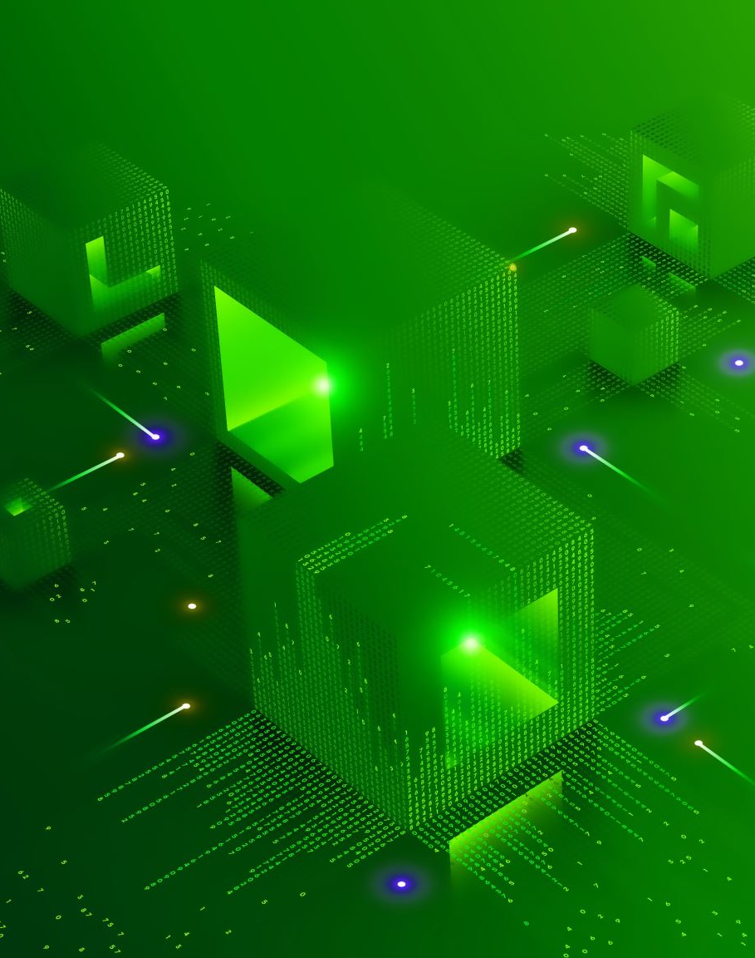
Environment Setup
Objective: Create a Python environment for Machine Learning (ML) and Deep Learning (DL) with GPU support.
Key Actions:
Setup: Created Conda environment using DummyAI.yaml File
Packages: Includes Python 3.8, Jupyter Notebook, TensorFlow, CUDA, and more.
Outcome: A ready-to-use ML/DL environment with GPU acceleration.

